Slide 2
MICAH 6:8
He has shown you, O mortal, what is good. And what does the Lord require of you? To act justly and to love mercy and to walk humbly with your God.

Slide 3
Matthew 22:36-39
“Teacher, which is the greatest commandment in the Law?”
Jesus replied: “‘Love the Lord your God with all your heart and with all your soul and with all your mind. This is the first and greatest commandment. And the second is like it: ‘Love your neighbor as yourself.’

Slide 4
Matthew 28:18-20 “All authority in heaven and on earth has been given to me. Therefore go and make disciples of all nations, baptizing them in the name of the Father and of the Son and of the Holy Spirit, and teaching them to obey everything I have commanded you. And surely I am with you always, to the very end of the age.”

Slide 6
To Know and Worship God
To Mature in Faith and Love
To Make Jesus Christ Known

Slide 7
Bear Creek Community Church is a caring church family loving people on their journey towards Jesus

Slide 10
Gathering together to glorify God

Slide 11
Sing to the Lord, all the earth; proclaim his salvation day after day.
Declare his glory among the nations,
his marvelous deeds among all peoples.
For great is the Lord and most worthy of praise;
he is to be feared above all gods.
For all the gods of the nations are idols,
but the Lord made the heavens.
Splendor and majesty are before him;
strength and joy are in his dwelling place.

Slide 12
Ascribe to the Lord, all you families of nations,
ascribe to the Lord glory and strength.
Ascribe to the Lord the glory due his name;
bring an offering and come before him.
Worship the Lord in the splendor of his holiness.
Tremble before him, all the earth!
The world is firmly established; it cannot be moved.
Let the heavens rejoice, let the earth be glad;
let them say among the nations, “The Lord reigns!”
2 Chronicles 16:23-31

Slide 14
"If mics fail, sound system dies, band sounds terrible, babies scream, & you lose your voice, but Jesus is gloried, it's a good Lord's Day."
-Ed Stetzer

Slide 15
Connecting People for Growing in Discipleship

Slide 16
Therefore, as God’s chosen people, holy and dearly loved, clothe yourselves with compassion, kindness, humility, gentleness and patience. Bear with each other and forgive one another if any of you has a grievance against someone. Forgive as the Lord forgave you. And over all these virtues put on love, which binds them all together in perfect unity.
Let the peace of Christ rule in your hearts, since as members of one body you were called to peace. And be thankful. Colossians 3:11-15

Slide 18
Connecting people for engaging in Jesus’ mission

Slide 19
For just as each of us has one body with many members, and these members do not all have the same function, so in Christ we, though many, form one body, and each member belongs to all the others. We have different gifts, according to the grace given to each of us. If your gift is prophesying, then prophesy in accordance with your faith; if it is serving, then serve; if it is teaching, then teach; if it is to encourage, then give encouragement; if it is giving, then give generously; if it is to lead, do it diligently; if it is to show mercy, do it cheerfully. -Romans 12:4-8

Slide 21
“The purpose of Christian salvation is not escape from the material world, but the redemption, the renewal, the healing, of the material world. Therefore, not only salvation of the soul and forgiveness of sins, but fighting disease and poverty and injustice is on the agenda of the salvation of God.”
Tim Keller

Slide 25
Heaven
Earth

Slide 26
Heaven
Eden (delight)
Earth

Slide 27
Heaven
Temple
Earth

Slide 28
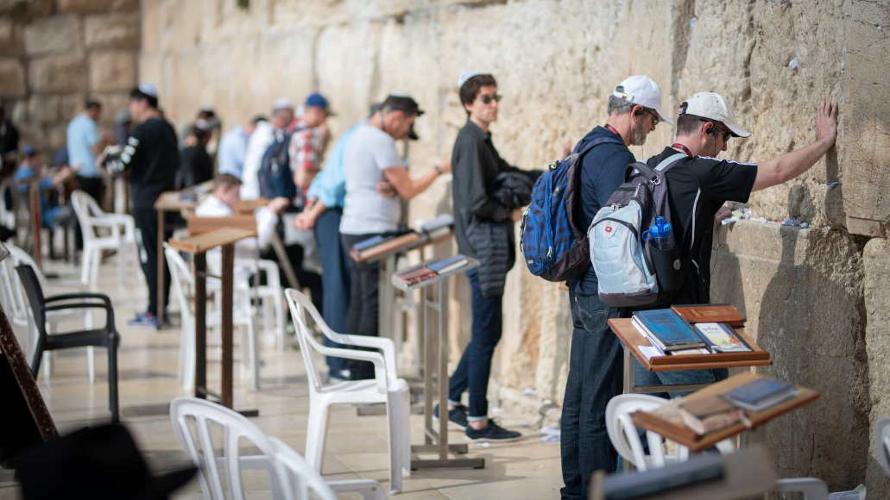
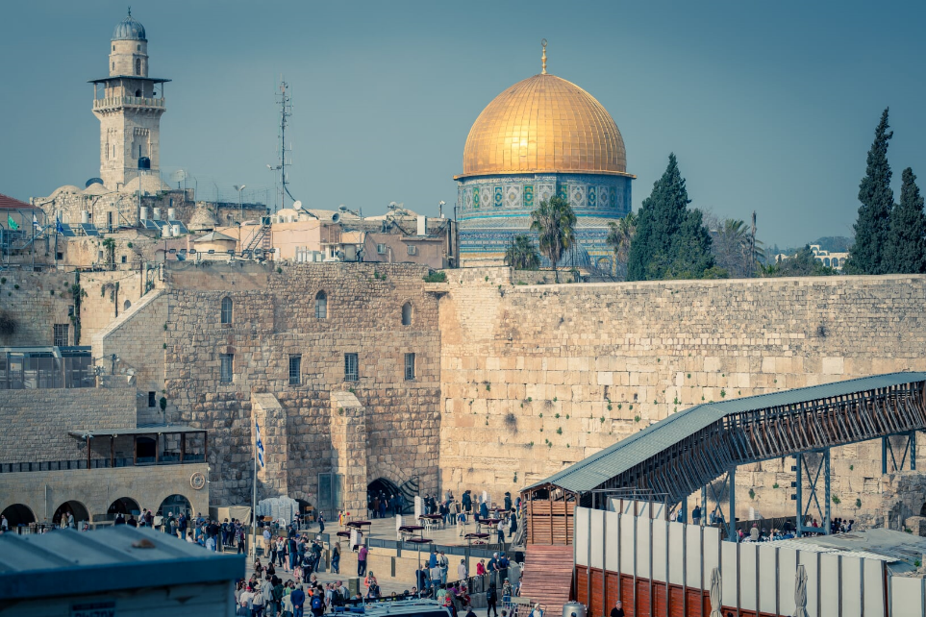
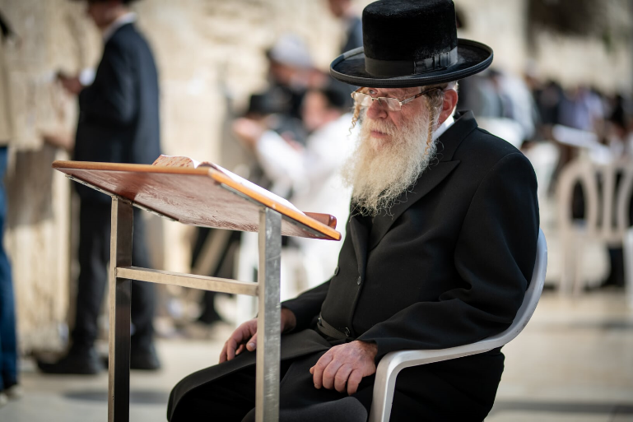

Slide 29
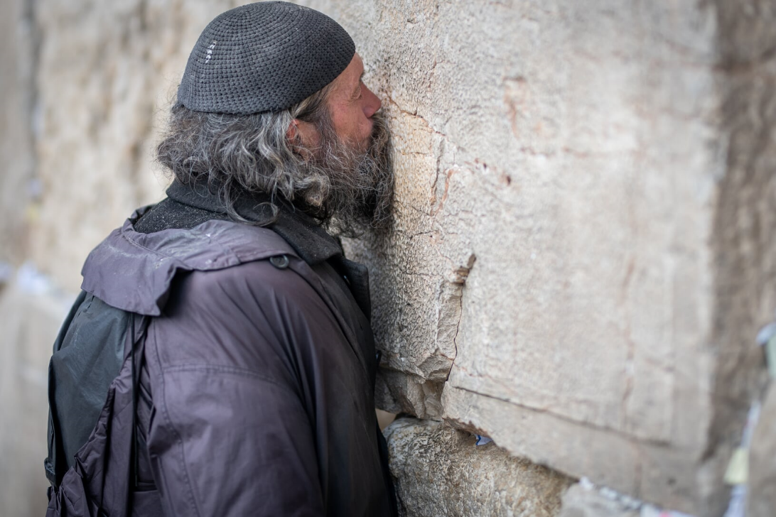
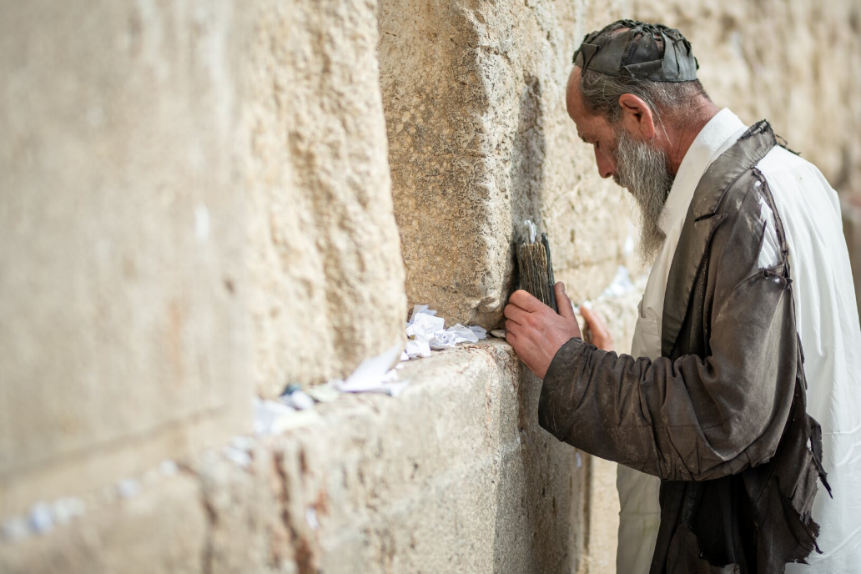

Slide 31
As you come to him, the living Stone—rejected by humans but chosen by God and precious to him— you also, like living stones, are being built into a spiritual house to be a holy priesthood, offering spiritual sacrifices acceptable to God through Jesus Christ. 1 Peter 2:4-5

Slide 32
But you are a chosen people, a royal priesthood, a holy nation, God’s special possession, that you may declare the praises of him who called you out of darkness into his wonderful light. Once you were not a people, but now you are the people of God; once you had not received mercy, but now you have received mercy.
1 Peter 2:9-10

Slide 33
Earth

Slide 34
We is the temple
Earth

